Slide 1
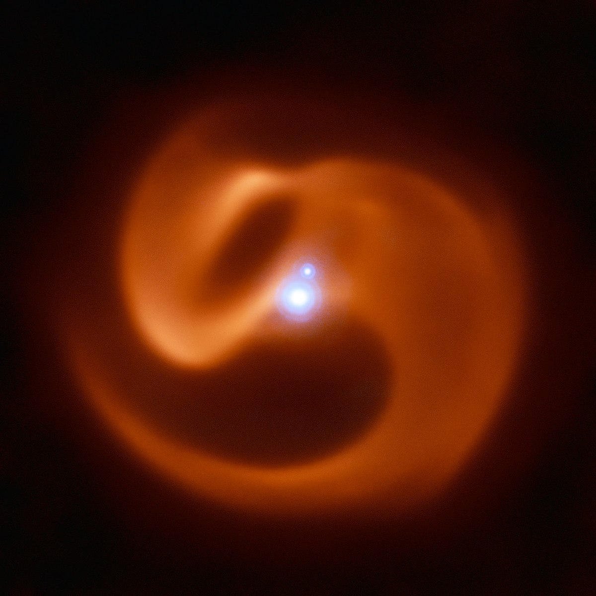
Modelling Spiral Dust Plumes Created from Wolf-Rayet Colliding Wind Binaries
Ryan White (UQ)
Benjamin Pope (UQ)
Peter Tuthill (USyd)

Slide 2
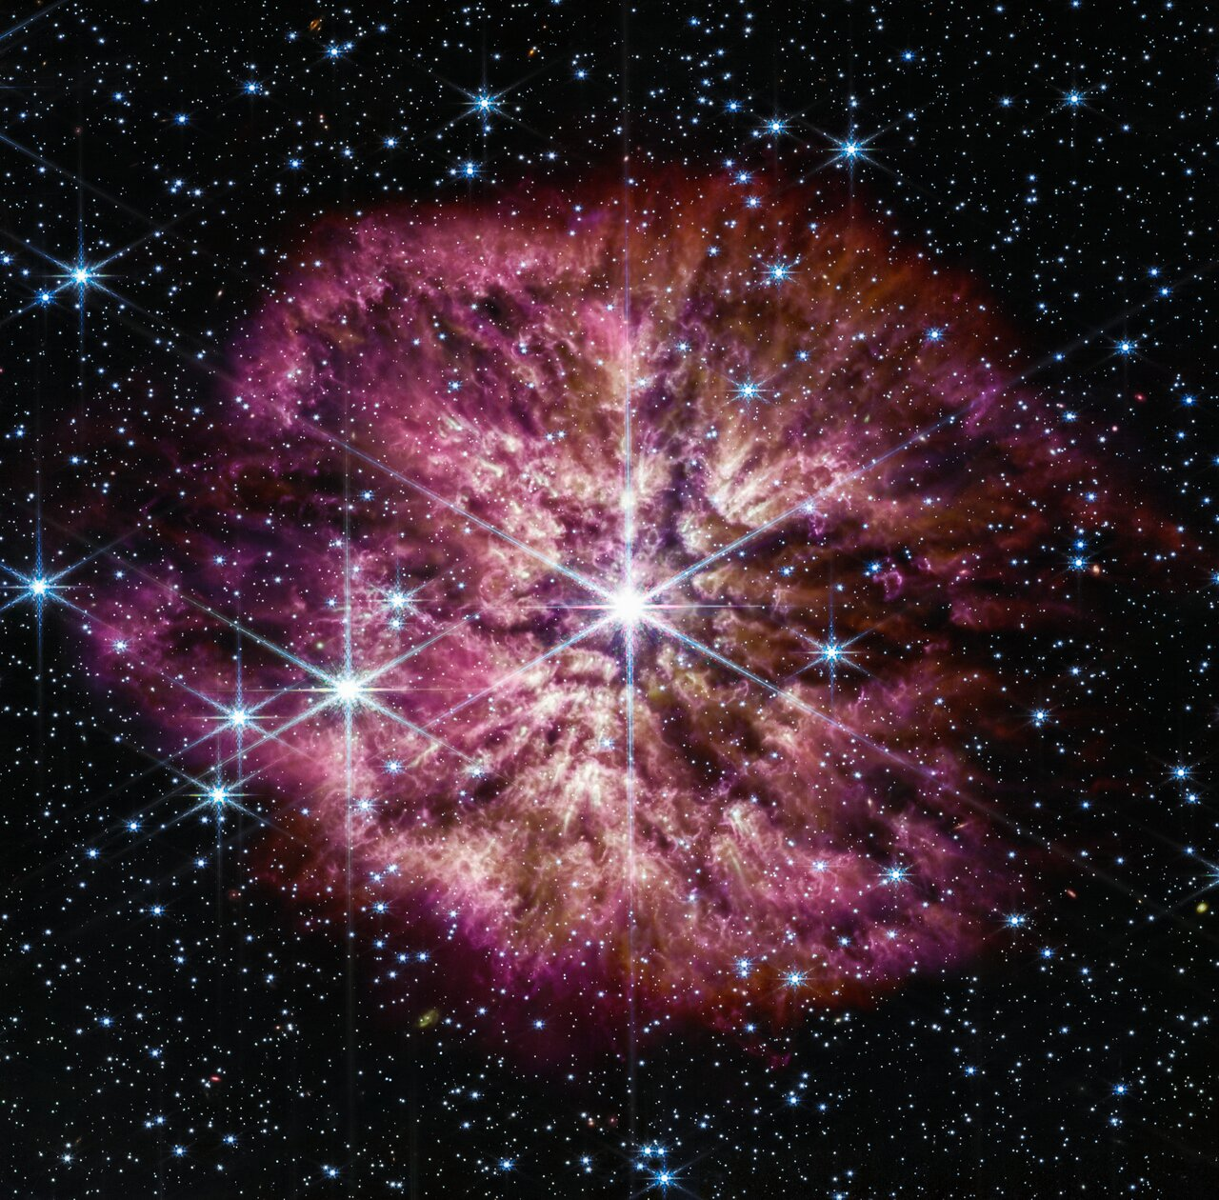
Wolf-Rayet Stars
Massive, extremely hot stars near the end of their lives
Very fast evolution
Core-collapse supernova progenitors
Produced some of the first carbon and heavy elements in the Universe
Few and far between in the present epoch, but common in young galaxies
WR124 NIRCam+MIRI Composite, NASA, ESA

Slide 3
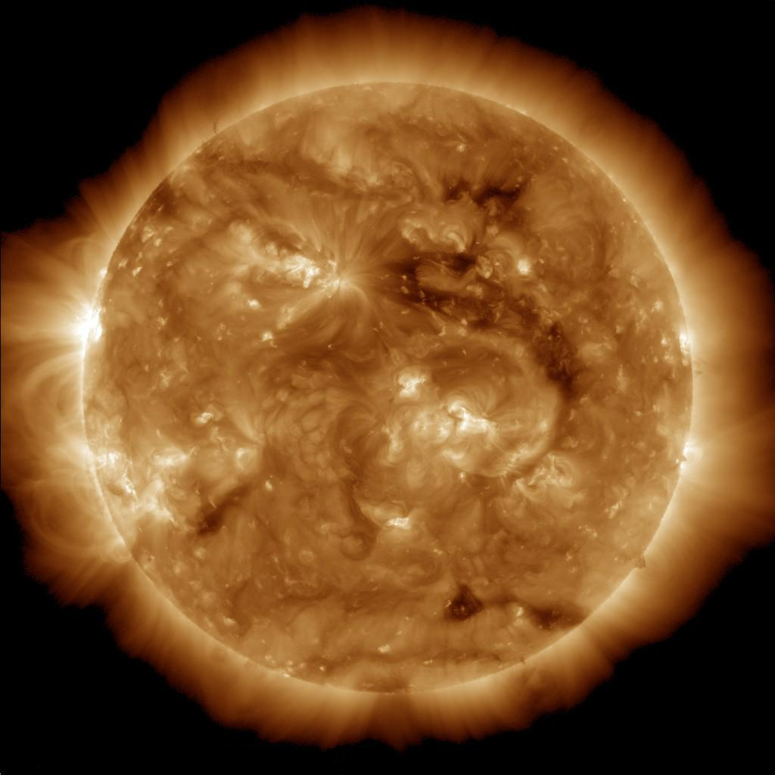
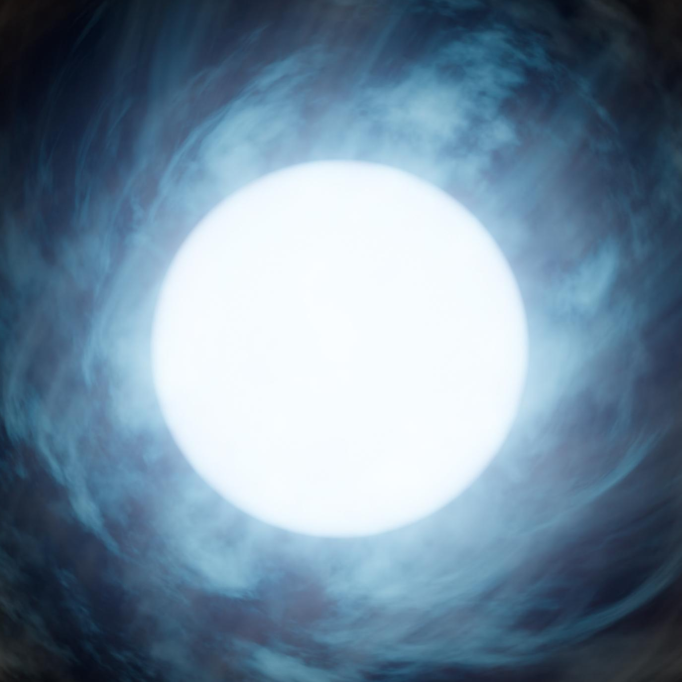
Wolf-Rayet Stars
The Sun
Wolf-Rayet Star

Slide 4
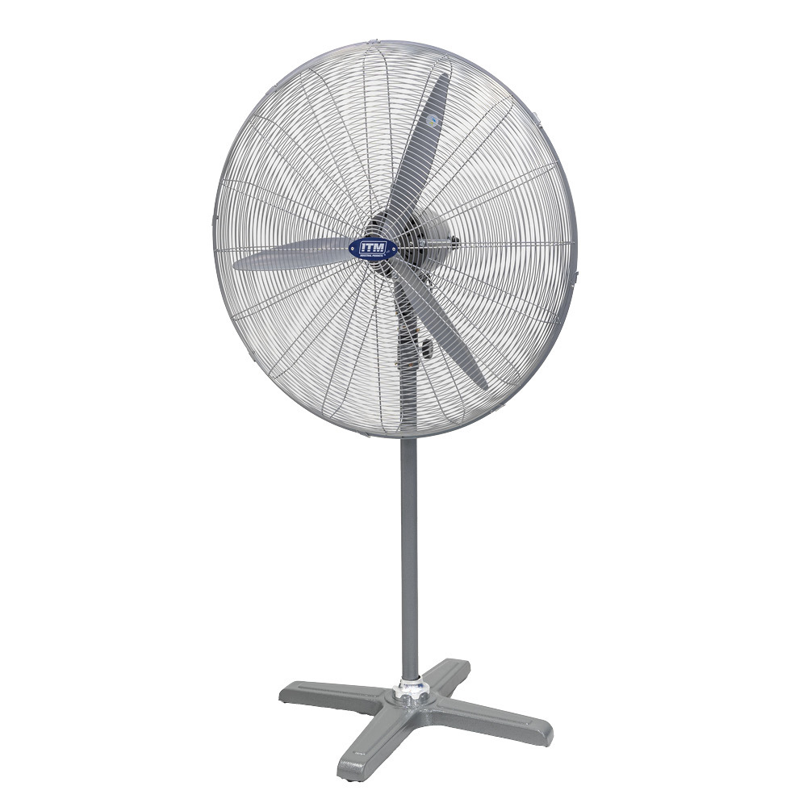
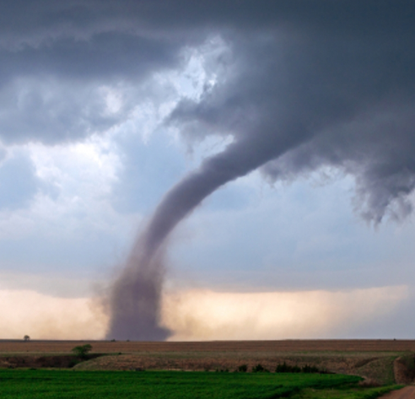
Wolf-Rayet Stars
The Sun
Wolf-Rayet Star

Slide 5
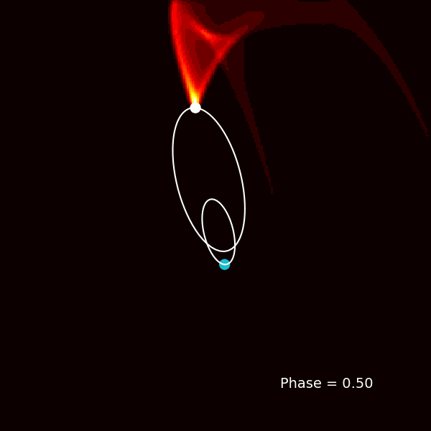
Colliding Wind Binaries
Considerable proportion of WRs are in “colliding wind” binaries with O/B/WR companions
Spiral plumes created as massive stars orbit each other
Dust nebulae are dynamic and repeating on ~human timescales!
Only first imaged ~20 years ago, as they’re bright in the infrared and require very high angular resolution

Slide 6
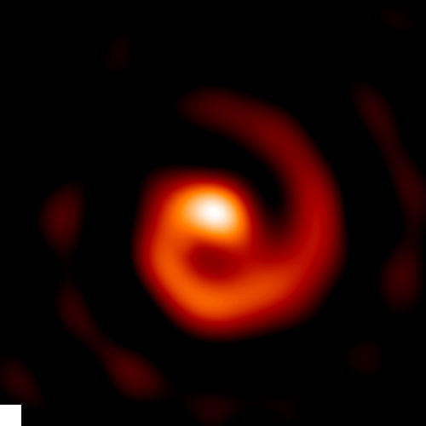
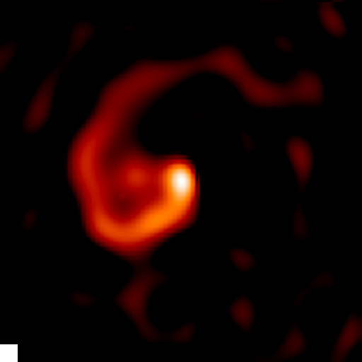
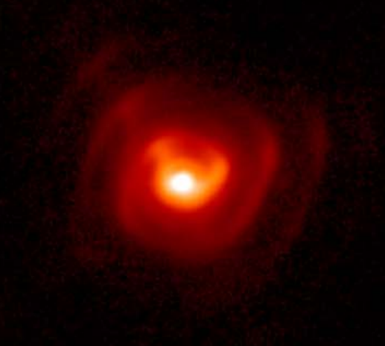

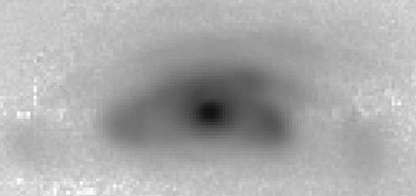
Colliding Wind Binaries
WR104
WR98a
WR112
Apep
WR48a

Slide 7
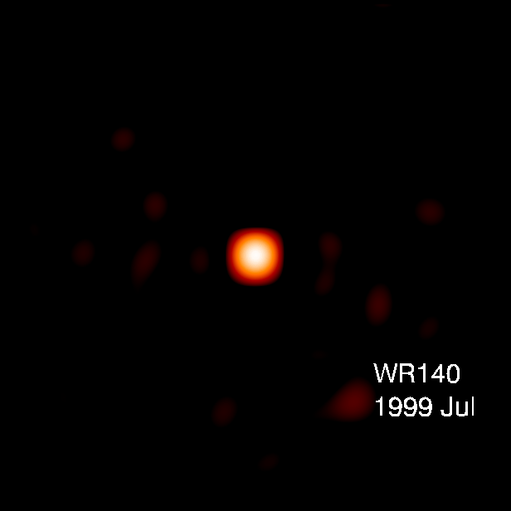
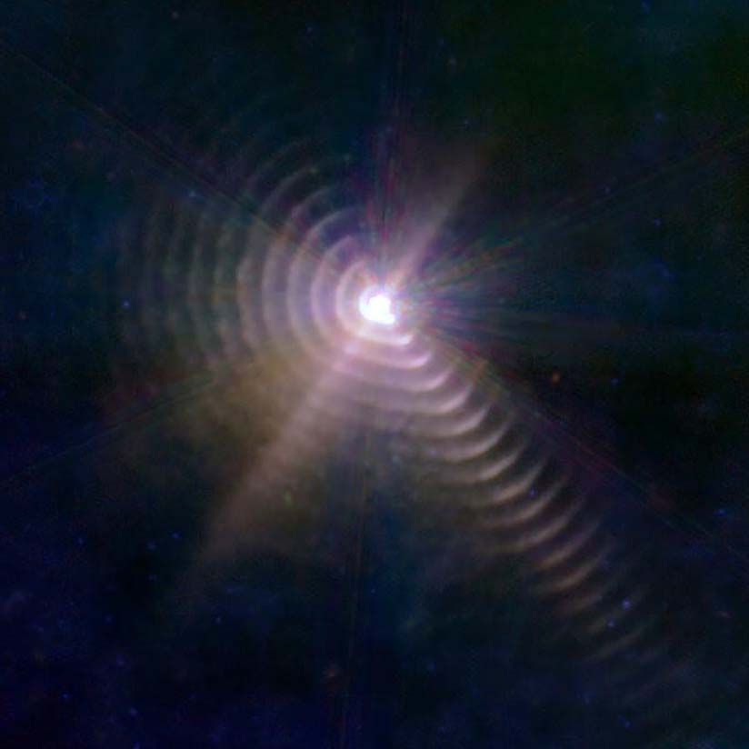
Colliding Wind Binaries

Slide 8
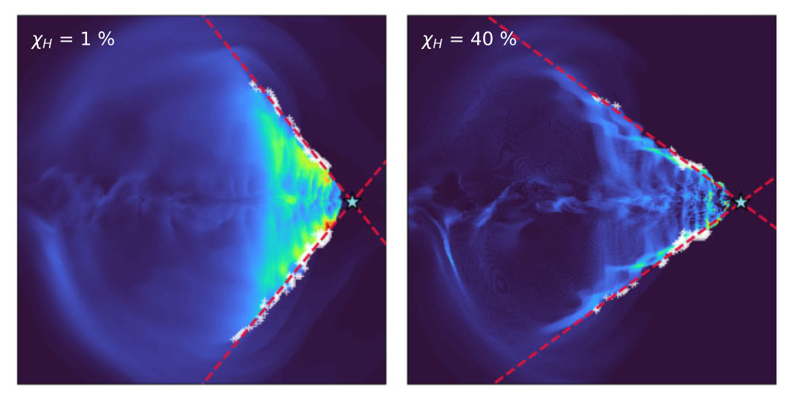
Colliding Wind Binaries
Spiral plumes encode stellar and orbital characteristics
Turbulent dynamics in the colliding wind region result in dust nucleation along a shock cone
Created dust is very bright in the near to mid IR
Hydrodynamical simulations reproduce physics well, but can’t quickly infer parameters
Soulain et al MNRAS 2022.

Slide 9
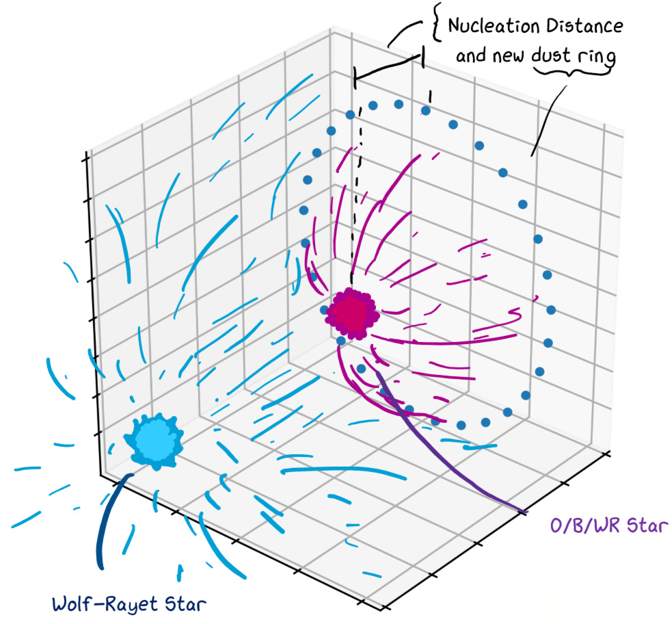
Modelling the dust plumes

Slide 10
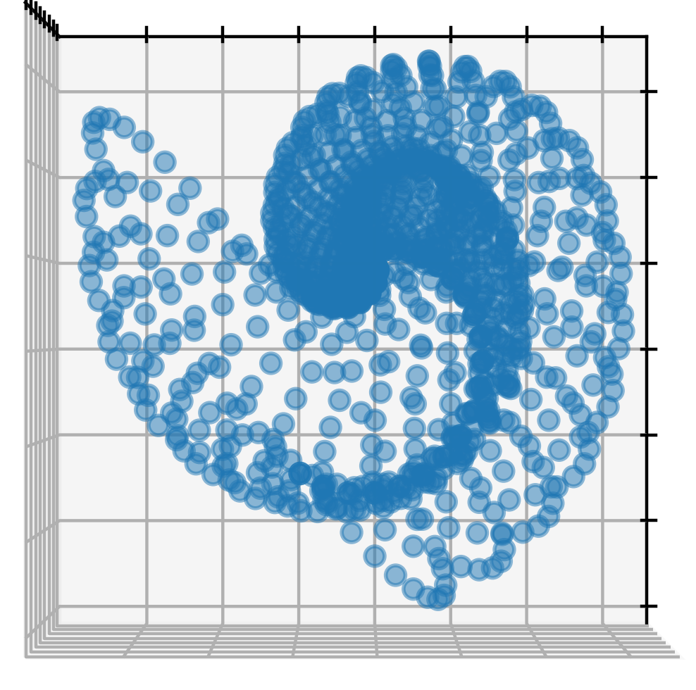
Modelling the dust plumes
Notes:
sgssa

Slide 11
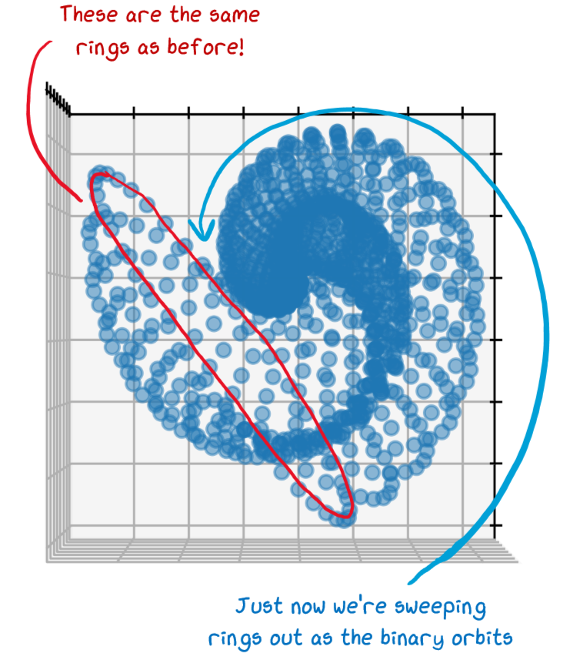
Modelling the dust plumes
Notes:
sgssa

Slide 12
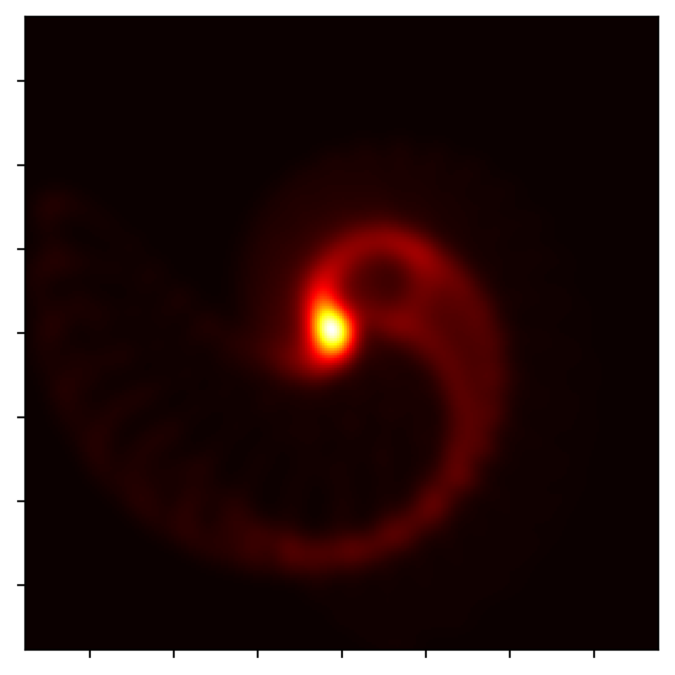
Modelling the dust plumes
Notes:
sgssa

Slide 13
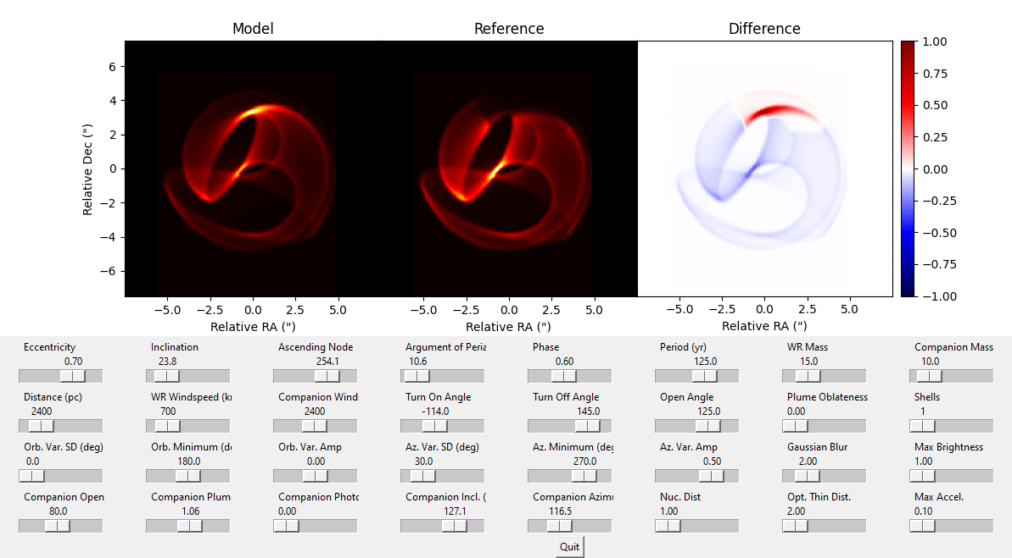
Speeding up the code
Notes:
sgssa

Slide 14
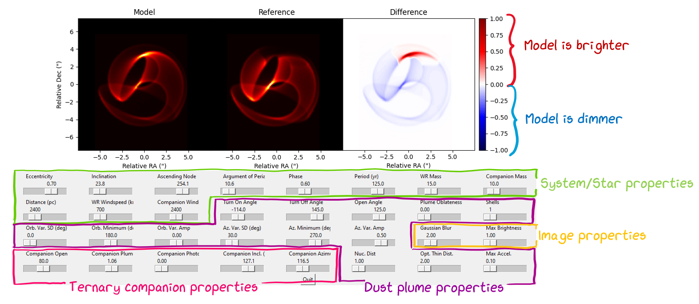
Speeding up the code
Notes:
sgssa

Slide 15
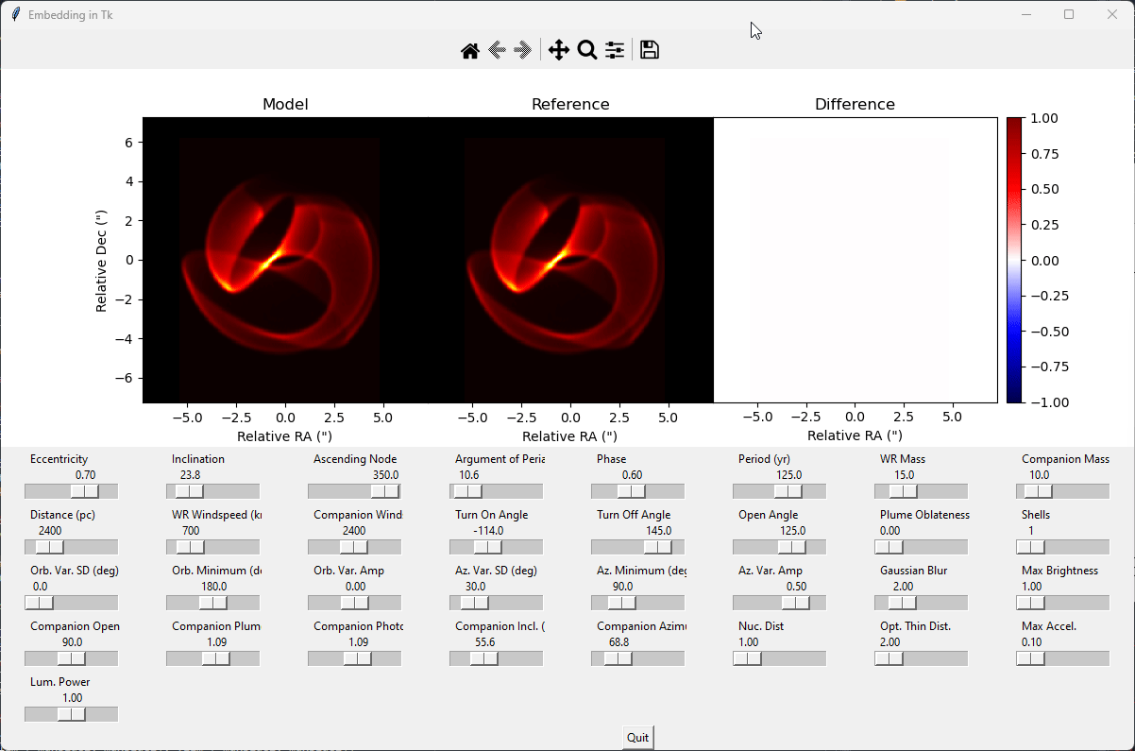
Speeding up the code
Notes:
sgssa

Slide 16
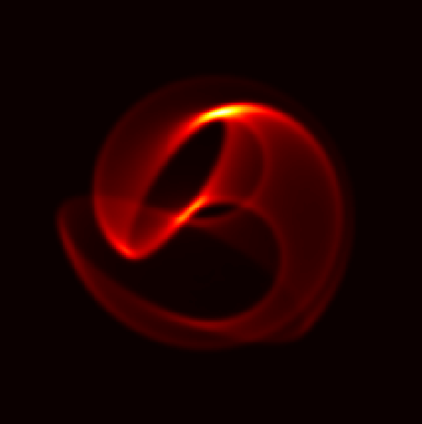
Ternary effects in Apep?

Slide 17
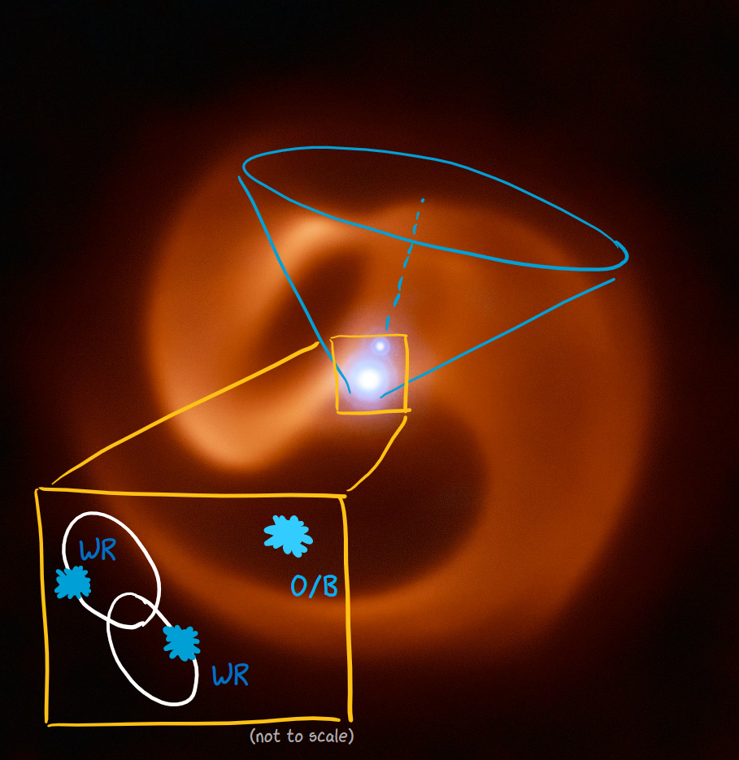
Ternary effects in Apep?

Slide 18
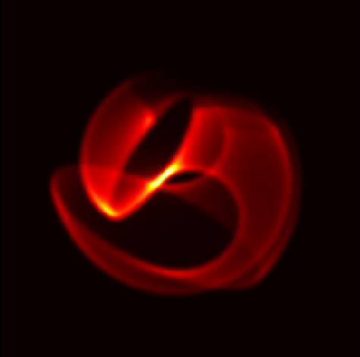
Ternary effects in Apep?

Slide 19
Degeneracy in our model
Low eccentricity
Late phase
Slow windspeed
Long period
High eccentricity
Early phase
Fast windspeed
Short period

Slide 20
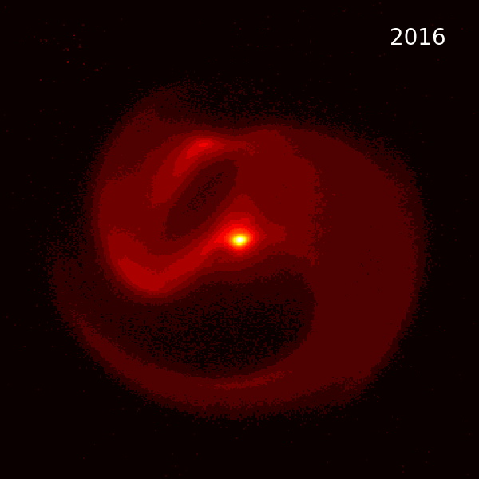
Degeneracy in our model

Slide 21
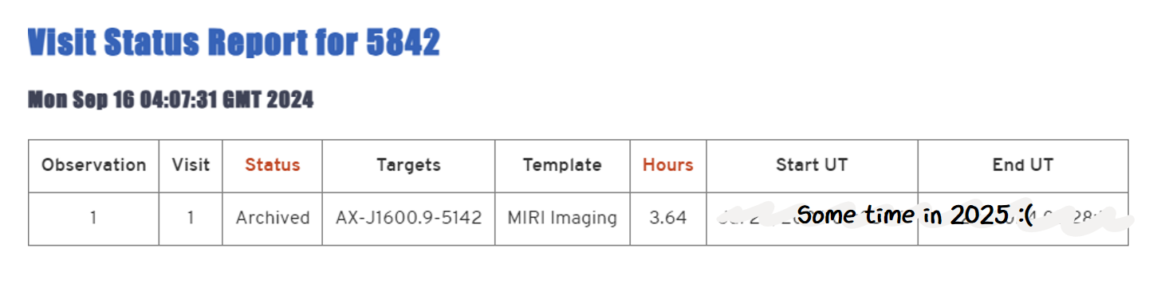
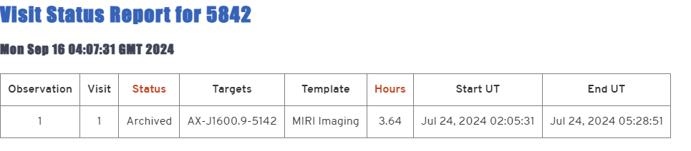
What about JWST?

Slide 22
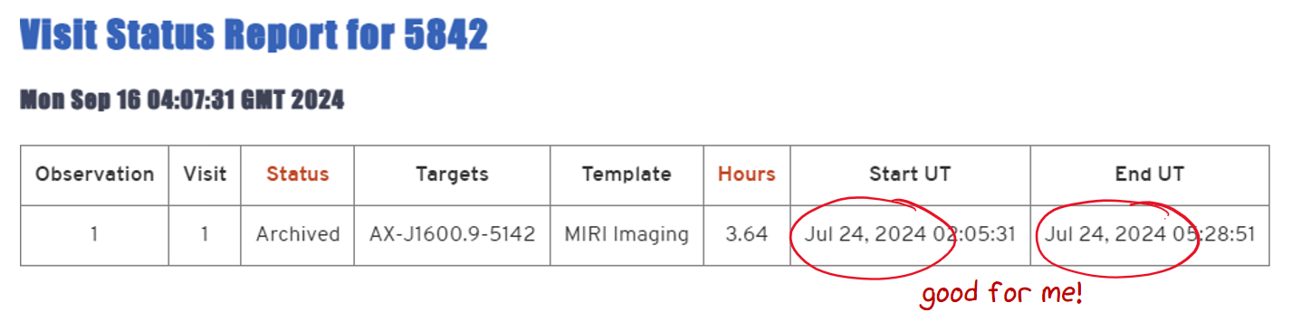
What about JWST?

Slide 23
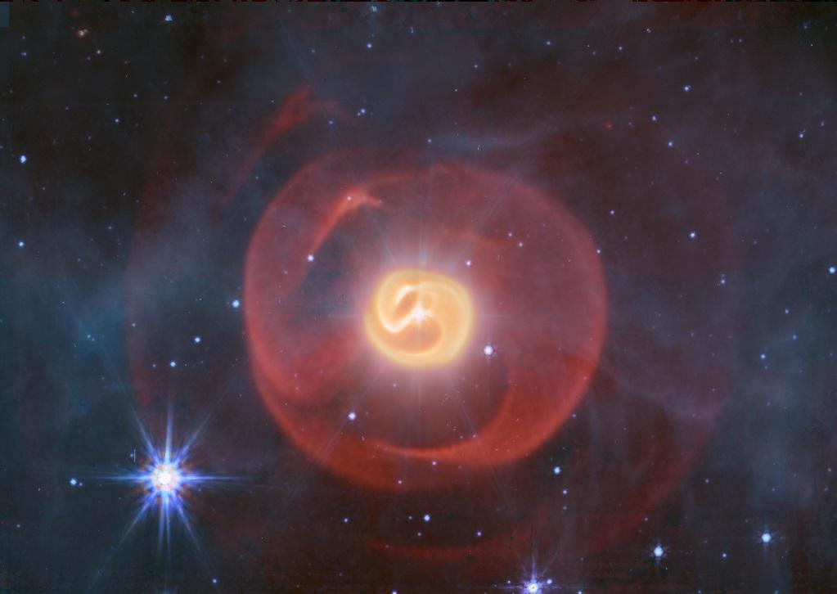
**Please don’t photograph or share! This image is secret and I’ll get in trouble!**

Slide 24
Questions?

